Slide 1


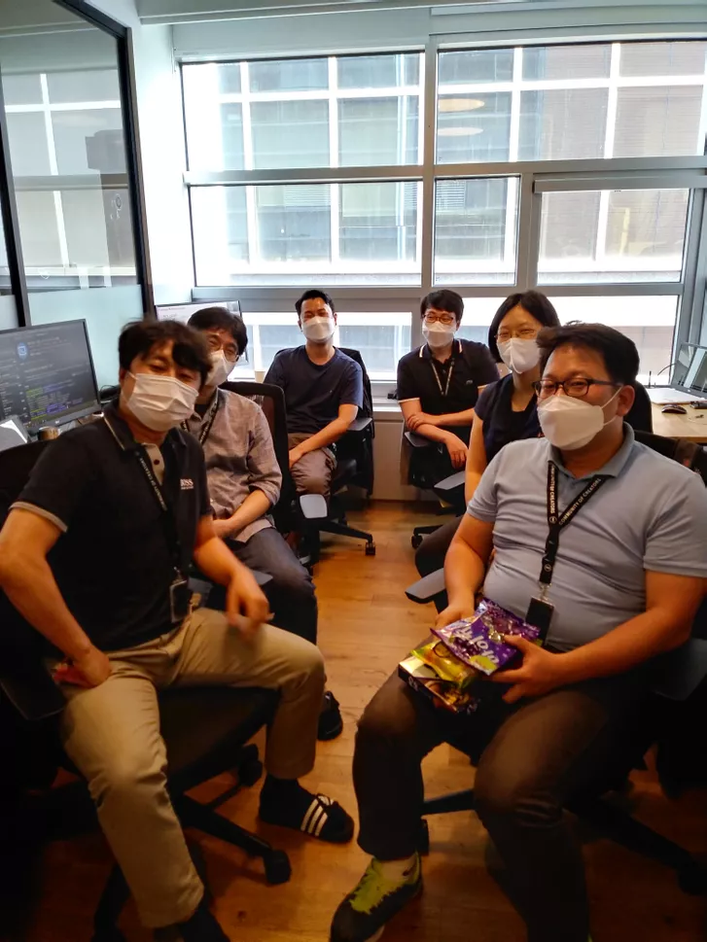
Phase 1 Presentation
Team 3
Notes:
Hello I’m hyungjin choi.
Let me introduce our studio project.
we are team3, known as 100% certified (In korean words, it says 백퍼인증)

Slide 2

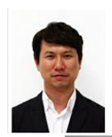
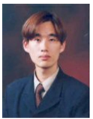
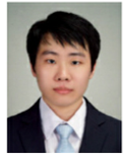

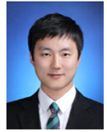
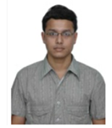

Team 3 - Member Introduction
Name | Kyuwoon Kim | Gyeonghun Ro | Wonyoung Chang | Soohyun Yi | Hyejin Oh | Hyungjin Choi | Vibhanshu Dhote | Cliff Huff
Role & Responsibility | PC App Development, Requirements, Threat Modeling, Security Implementation | Project Manager, Test case, Architect, Requirements, Threat Modeling | PC App/Embedded Development, Environment, Requirements, Threat Modeling | Embedded Development, Static Analysis, Requirements, Threat Modeling | Documentation, Security Standards, Requirements, Threat Modeling, Static Analysis | Embedded Development, Tool Research, Requirements, Threat Modeling | Vulnerability Research, Requirements, Threat Modeling | Mentor
LGE Email | kyuwoon.kim@lge.com | gyeonghun.ro@lge.com | wonyoung.jang@lge.com | soohyun.yi@lge.com | hyejin.oh@lge.com | jin0925.choi@lge.com | vibhanshu.dhote@lge.com
Personal Email (CMU account) | mnik83@gmail.com | gyeonghun.ro@gmail.com | wonyoungjjang@gmail.com | randelx@gmail.com | chaolly007@gmail.com | zzzzdx@gmail.com | dhotevibhanshu@gmail.com | cch@sei.cmu.edu
Alias Email of Team 3 : cmu-team3@lge.com
Notes:
팀원 소개 - 멘토
Our teammates are 7.
6 are in Korea
one of our member(Vibhanshu) is in India
And our mento cliff is in the states.
so we had a difficulty with setting up on-line meeting, because of jet-lag.

Slide 3

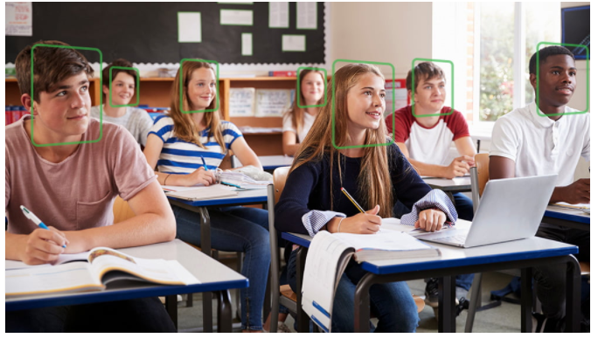

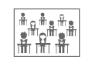


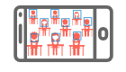
Project Overview - Redefining for practical implementation
[ CMU Student Attendance Check System ]
Students in the classroom
“100% recognition engine”
find faces and recognize who they are.
The face and name recognized by the system are displayed.
Student attendance is checked.
Notes:
프로젝트 소개 (요구사항 목표가 불분명하여, product에 대입하여 redefining하였다)
First or all, we discussed about our studio project with AI recognition system.
A few ideas came up with, however we made our system for AI Attendance check system. (now please call AACS, we have a plan to develop and provide it to CMU later.)
The system overview is that
AI engine learn student image from camera and recognize who they are.
After recognized face and their name are displayed on screen and AACS also should check student attendance. => Then, a professor no longer has to call attendance list.

Slide 4


Context Diagram
Camera & Image analysis app
User Display & System Control app
Student
Admin
Face Recognition System
(FRS)
Attendance Check System
(ACS)
Student
legend
boundary
System
App
camera
user
Network
Connection
Notes:
AACS can be divided into two separate areas.
Left system is called Face Recognition system (FRS)
This area is for the Jetson Nano board.
FRS has a camera to register student face, identify students by AI algorithm, and could check student attendance.
And the Attendance Check system area(called ACS), is for windows PC where the Control app is installed.
FRS and ACS are connected by network connection.

Slide 5
Security Goal
AACS Security Goal :
Confidentiality : The sensitive data(User DB, Video, Face data ... ) in the system should be accessible
only by the authorized people.
Integrity : The sensitive data in the system should not be tampered by an attacker.
Availability : The attendance system should be available at all times during the semester.
Notes:
Here are 3 security goal
Confidentiality
sensitive data(User DB, Video, Face data ... ) in the system should be accessible only by the authorized user
Integrity
sensitive data in the system should not be tampered.
Availability
It is available at all times during semester for checking attendance

Slide 6

Project Overview
AI Attendance Check System
Demo
Enjoy a cup of coffee during the attendance check time
Notes:
Let’s play our demo
Login fail scene (a user do not have USB could not access)
Login success scene
Student registration
Student delete face
Live attendance scene
Recorded attendance scene

Slide 7
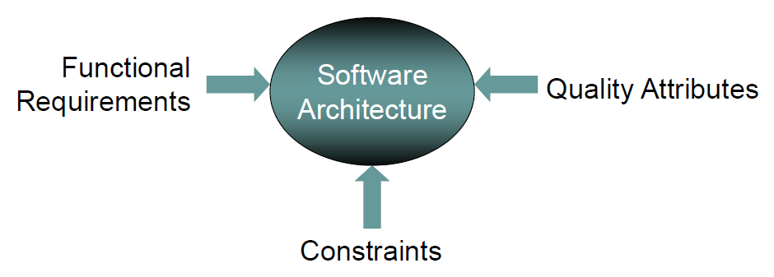
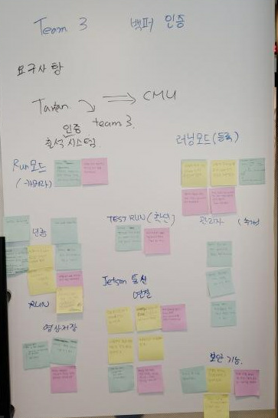
Deriving architecture drivers
Item | Category | Count
Functional requirements | log in | 9
 | register of student (Learn mode) | 5
 | attendance check (Run mode, Test run mode) | 8
 | security | 29
 | total | 51
Quality Attribute |  | 10
Constraints |  | 8
Original requirements : 75%
Additional requirements : 25%
Notes:
For developing AACS,
First of all, we need to generate functional requirements by brainstorming.
In order to derive the software architecture drivers, we thought about Quality attributes and Constraints.
With this process, 25% of the additional requirements increased compared to requirements of original studio project

Slide 8

User DB
Initial Design
Camera Device
Engine
id, pw
userdata
Engine data
User Auth
Manager
Student
Controller
images
AI Manager
Config setting
result
ip/port
id
video/vlist
video
id, pw
result
video/
vid/videolist
Video DB
vid
id/password
request
(id, #pic)
Comm Manager
(FRS)
Comm Manager
(ACS)
User
Auth
Manager
result
Face
Manager
id/password
photo list
video list/video/uid
Attendance Controller
User
vid req
uid,fid
result
Face Recognition System
Attendance
Check
System
Face DB
time/uid
time/uid
log
Attendance DB
legend
thread
storage
external
device
data
flow
Notes:
This is Initial design
FRS have User datebase and it is by controlled by UserAuthManager
and Video db and engine data are handled by AI Manager which is connected with Camera device.
and Face db is controlled by FaceManager.
FRS and ACS are connected by network connection.
And also ACS have userAuthmanager, attendance and student controller

Slide 9
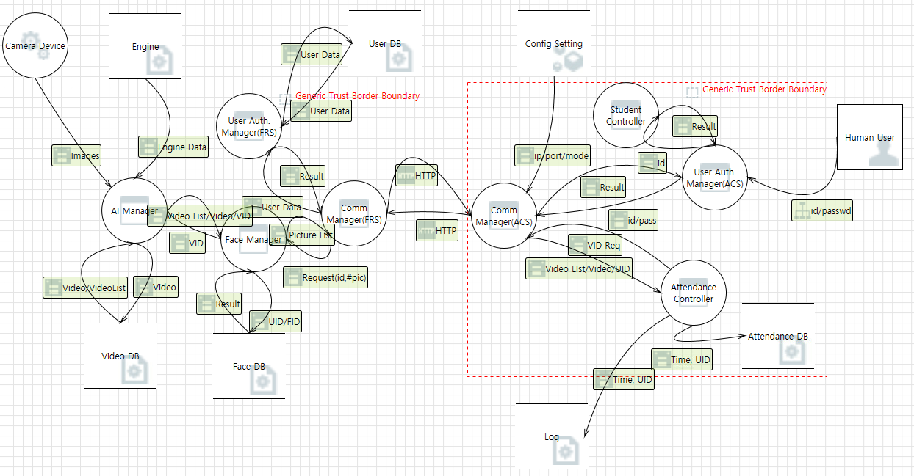
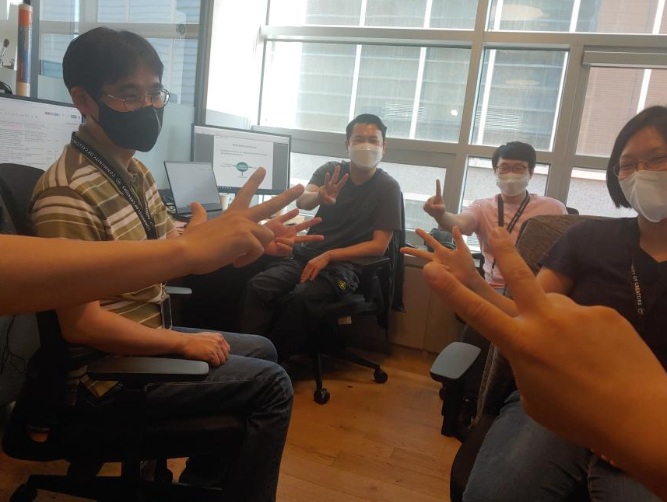
Threat Analysis & Risk Assessment
[ Voting for risk assessment ]
Threat Analysis | Risk assessment for high priority threats | Security Requirements from threat mitigation
138 | 29 | 23
Notes:
From initial design, we performed the Threat analysis.
and found 29 high priority threats.
By voting the likelihood and impact, 23 security requirements were derived from threat mitigation

Slide 10
Security Requirements from risk assessment
limited photos | Each student must be able to save up to 5 photos.
check capacity | When saving student photos, this system should be able to check the remaining capacity.
check capacity | When saving a video about attendance, this system should be able to check the remaining capacity.
separate partition | This system should be able to save the video of the attendance in a separate partition.
operation | This system should be able to operate the attendance function even if it is not possible to save the video of the attendance.
encryption | Videos of attendance in this system must be encrypted.
hash | User accounts accessing this system must be hashed.
hash | Config setting file that manages device information stored in the system should be hashed
encryption | Face DB in the system must be encrypted.
input validation | When logging into the system, the input data should be verified.
sign | Face DB data stored in the system must be signed by admin.
encryption | Video DB data stored in the system must be encrypted.
sign | Video DB data stored in the system must be signed by admin.
encryption | User DB data stored in the system must be encrypted.
sign | User DB data stored in the system must be signed by admin.
heart beat | The system's Comm Manager (ACS) must apply a heart beat.
input validation | Input verification for the Config setting in the system should be done.
hash | AI Engine data shall be hashed.
input validation | Input verification for engine data in the system should be done.
data loading | It is necessary to check the loading completion of the engine data of the system.
input validation | The Comm Manager (FRS) in the system should verify the input.
TLS | TLS version 1.2 and above is needed must be applied for communication between FRS and ACS in the system.
1. Input Validation
2. Encryption
3. Sign
4. Hash
5. Secure Communication
Notes:
Those security requirements from risk assessment, it is classified into 5 main items.
Input validation, data encryption, sign, hash, and secure communication

Slide 11





User DB
Re-Design with Security Requirement
Camera Device
Engine
id, pw
userdata
Engine data
User Auth
Manager
Student
Controller
images
AI Manager
Config setting
result
ip/port
id
video/vlist
video
id, pw
result
video/
vid/videolist
Video DB
vid
id/password
request
(id, #pic)
Comm Manager
(FRS)
TLS
Comm Manager
(ACS)
User
Auth
Manager
result
Face
Manager
id/password
photo list
video list/video/uid
mutual authentication
Attendance Controller
User
vid req
uid,fid
result
Face Recognition System
Attendance
Check
System
Face DB
time/uid
time/uid
log
Attendance DB
legend
thread
storage
external
device
data
flow
encryption
input
validation
sign
hash
decryption
Notes:
So, we re-designed system architecture so that it can be applied to the entire system as a security requirement,
The main 5 items of security requirements are diagrammed according to its purpose.
secure communication is designed by using TLS protocol.
However, we needed to discuss how to concrete it.

Slide 12
AACS Static view
Presentation
Layer
Login
Register of student
Attendance check
Business
Layer
Authentication
Face Recognition
Attendance Report
Privacy
Communication
Service
Layer
AI Manager
Face
Manager
User Auth
Manager
Comm
Manager
Attendance controller
Student
Controller
User Auth
Manager
Comm
Manager
Security
Layer
Encryption
Decryption
sign
Hash
Encryption
Decryption
Hash
Data
Layer
FaceDB
UserDB
VideoDB
Engine
Attendance DB
log
Config setting
FRS(Face Recognition System)
ACS(Attendance Check System)
Notes:
so we drew it to satisfy the security requirements by adding a security layer from the static view perspection.
we decided that it would be better have a security layer between service layer and data layer.

Slide 13
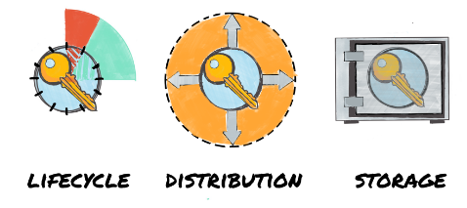
AACS Key Management
Category | Recommendations
Key lifecycle | Cryptographic key management is critical to the security of a cryptosystem. This includes the generation, exchange, storage, use, destruction and replacement of keys.
Key distribution | The generated keys shall be transported (when necessary) using secure channels and shall be used by their associated cryptographic algorithm within at least FIPS 140-2 compliant cryptographic modules.
Key storage | Ensure all keys are stored in cryptographic vault, such as a hardware security module (HSM) or isolated cryptographic service
Notes:
In addition, the important part to consider from a security point is the key management.
There are three categoies.
key lifecycle
distribution using secure channel
and safe key storage

Slide 14
AACS Key Management Architectural Alternatives
AACS-QA-010) Key management for system must be secure.
1.protected service request
1.protected service request
Comm
Manager
Comm
Manager
Comm
Manager
Comm
Manager
2. provide server certificate
2. provide server certificate
3. provide client certificate
3. provide client certificate
4. protected service executed
4. protected service executed
request store
key stored
request store
key stored
Key Store
Key Store
request store
key stored
request store
key stored
FRS
ACS
Key Store
Key Store
FRS
ACS
external USB
external USB
pre-install key management
external device key management
 | Pre-installed key management | External Device key management
Pros | Easy to distribution Easy to key management | Update usb to update key Securely distribution Secure key storage
Cons | Update the whole program to update the key The key is easy to be exposed to risk | Physical usb key management Difficult to distribution
Architectural Decision :
Selected as an external device key management for key lifecycle management and secure key management
Notes:
The initial concept was to the pre-install key as shown in the left screen, but one of teammate proposed to store in an external USB by using secure way.
As shown in the screen below, external storage has the advantage of safe management and secure storage. Of course, there is a cons like “Physical usb key management”
With it, we discussed that storing the key in an external storage has an architectural advantage.

Slide 15


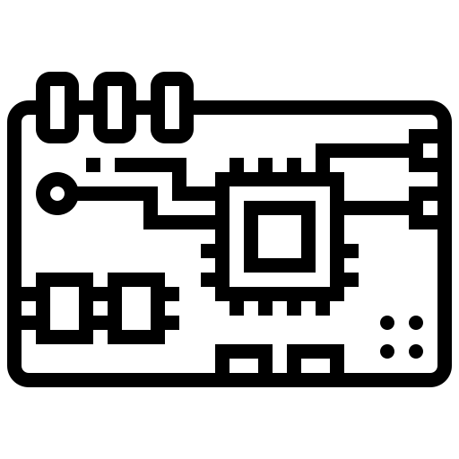





AACS Physical view
Face Recognition System
Attendance check system
Notes:
From the next slide, each system stores the key in an external device.

Slide 16
AACS Secure Design Pattern
principles for secure design
: defense in depth
principles for secure design
: keep it simple
AI Manager
Secure design pattern
: single point of access
DB
Simple interface
Face Manager
Security Manager
facade
pattern
User Auth
Manager
(Hide complexity / Provide simple interface)
input validation
encryption
sign
secure read/write
principles for secure design
: least privilege
Face
Video
User
secure read/write
secure read/write
secure read/write
: Each class performs encryption/decryption using a different key.
Notes:
To apply the secure design pattern, the facade pattern is applied, which can keep the (Hide complexity / Provide simple interface) principle.
it can keep the single point of access)
Simple interface : can keep the “keep it simple”
encryption and decryption using a different key : can keep the “least privilege”
and using three security method: can keep the “defense in depth”

Slide 17


AACS Secure UX
Secure design pattern
: Limited view
Each student has a permission to view only their own photo.
Students must register their faces in the attendance system.
Could you take a picture of your smiling face?
Add Picture
This function is designed to register the face of a registered student. Students can register up to 5 photos.
Add Photo
Delete Photo
Delete Picture
This is a function to delete a registered student's face photo.
Finish
password change
1/5
Notes:
In addition, by applying it secure UX, individual student only can access the registration screen. (they have Least privilege) it can keep the “Limited view”

Slide 18
Secure communication with TLS 1.3
Category | Recommendations | Applied to our project | Reason for selection
SSL/TLS version | TLS 1.2 or TLS 1.3 | TLS 1.3 | The latest version of TLS Don’t need to consider backward compatibility The highest level of security
Cryptographic library for TLS | GnuTLS OpenSSL wolfSSL | OpenSSL v1.1.1 - v1.1.1k (ACS) - v1.1.1 (FRS) | Widely used in industries for the commercial products
Cipher suites | Recommended for TLS 1.3 : TLS_AES_128_GCM_SHA256 TLS_AES_256_GCM_SHA384 TLS_AES_128_CCM_SHA256 | TLS_AES_128_GCM_SHA256 | AES-128 for performance
Signature keys for certificates | RSA : 2000 bits ~ (~2023) 3000 bits ~ (2024~2027+) | RSA-2048 bits | RSA-2048 bits for performance
Notes:
Now, let’s think about how to apply secure design to our project
TLS 1.3 is applied for secure communication
OpenSSL, v1.1.1k for ACS and v1.1.1 for FRS.
The cipher suites is TLS_AES_128_GCM_SHA256, and uses RSA algorithm and it’s key length is 2048 bits for signature, which was selected in consideration of performance.

Slide 19
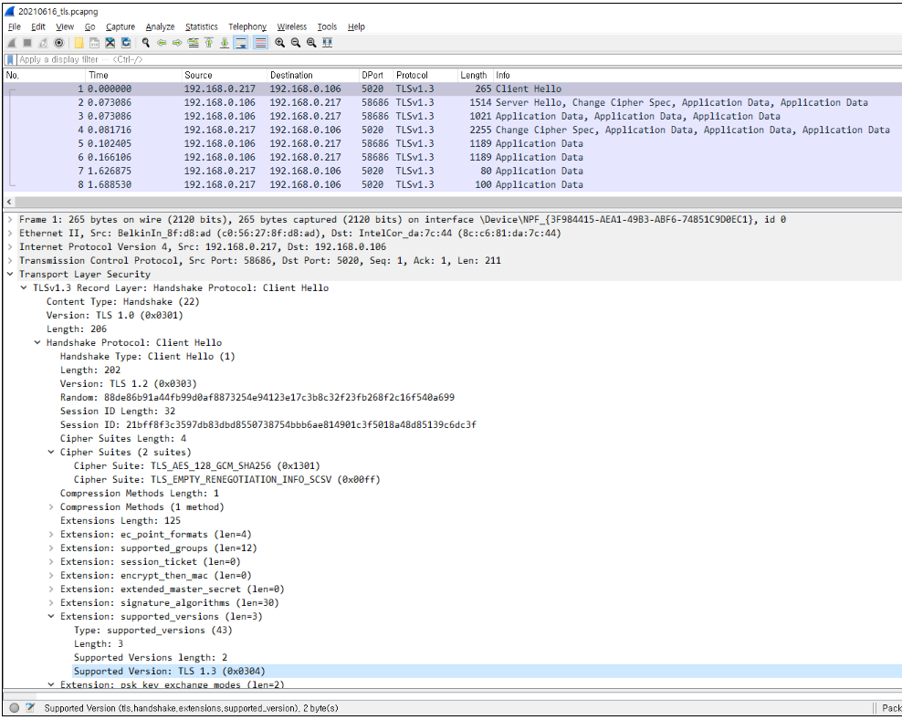

Secure communication with TLS 1.3
Notes:
It is possible to check applied the cipher suites using wireshark

Slide 20
Cryptographic Algorithms
Category | Recommendations | Applied to our project | Reason for selection
Block ciphers | AES-128, AES-192, AES-256 | AES-128 | Choose the shortest key length for performance
Mode of operation for block ciphers | CCM (Counter with Cipher Block Chaining Message Authentication) GCM (Galois/Counter Mode) CBC (Cipher Block Chaining) CTR (Counter Mode) | CBC | The most secure mode among the block cipher modes
Hash functions | SHA-256, SHA-512/256, SHA-384 and SHA-512 SHA3-256, SHA3-384, SHA3-512 | SHA-256 | Most widely used. Fast and strong enough for most purposes.
Digital signatures | RSA, DSA, ECDSA, ECKDSA, ECGDSA, XMSS+ or LMS | RSA-2048 bits | Most widely used.
Notes:
AES-128 and CBC were applied to data encryption/decription, and it was selected in consideration of security and performance perspection.
The hash function uses SHA-256, and the RSA-2048 bits algorithm was used for the digital signature.

Slide 21
Cryptoperiod
No. | Key Type | Cryptographic keys stored in FRS USB | Cryptographic keys stored in ACS USB | Cryptoperiod Recommended
 |  |  |  | Originator-Usage Period (OUP) | Recipient-Usage Period
1 | Private signature key | Private signature key for signing Video DB Private signature key for signing User DB Private signature key for signing Face DB |  | 1 to 3 years | -
2 | Public signature-verification key | Public signature-verification key for Video DB Public signature-verification key for User DB Public signature-verification key for Face DB Root CA certificate | Client certificate Root CA certificate (self-signed certificate) | Several years (depends on key size)
4 | Private authentication key | Server key | Client key | 1 to 2 years
5 | Public authentication key | Server certificate Root CA certificate | Client certificate Root CA certificate (self-signed certificate) | 1 to 2 years
6 | Symmetric data encryption key | Symmetric data encryption key for encrypting Video DB Symmetric data encryption key for encrypting User DB Symmetric data encryption key for encrypting Face DB |  | Up to 2 years | Up to OUP + 3 years
NIST SP 800-57
Applied to our project
Root CA certificate cryptoperiod : 1 year
Client/Server certificate cryptoperiod : 3 months
** Root CA private key, Private signature key for signing client configuration file are located in Admin PC
Notes:
And next, we discussed about cryptoperiod in relation with the key lifecycle.
From recommendation by NIST SP 800-57,
Root CA certificate replacement cycle is planned for one year,
Each client/server certificate is planned for 3 months.

Slide 22
Security Assessment Reports
1) Static Analysis Report based on RATS
2) Open Source Vulnerability Report
Folder | High | Low | Medium | Total
ControlAndDisplay(ACS) | 6 | 2 |  | 8
LgFaceRecDemoTCP_Jetson_NanoV2(FRS) | 6 | 9 | 6 | 21
Total | 12 | 11 | 6 | 29
OSS Name / Version | High | Low | Medium | Total
NVIDIA Tegra kernel v4.9 | 1 |  | 2 | 3
OpenCV v4.1.1 |  |  | 1 | 1
OpenSSL v1.1.1 | 2 | 2 | 8 | 12
Total | 3 | 2 | 11 | 16
Issue | High | Low | Medium | Total
EVP_DecryptUpdate |  |  | 1 | 1
EVP_EncryptUpdate |  |  | 1 | 1
fixed size global buffer | 10 |  |  | 10
fixed size local buffer |  | 7 |  | 7
memcpy |  | 4 |  | 4
read |  |  | 4 | 4
wsprintf | 2 |  |  | 2
Total | 12 | 11 | 6 | 29
https://security.web.cern.ch/recommendations/en/codetools/rats.shtml
Notes:
Here is the security assessment analysis
Finally, 29 items were detected by static analysis tool RATs
Compared to the 20 items was detected in the initial project, it increased slightly.
however, we practiced secure coding in the implement stage, and it could be mitigated.
In addition, the results of vulnerabilities in the open source applied to our project are as shown.

Slide 23


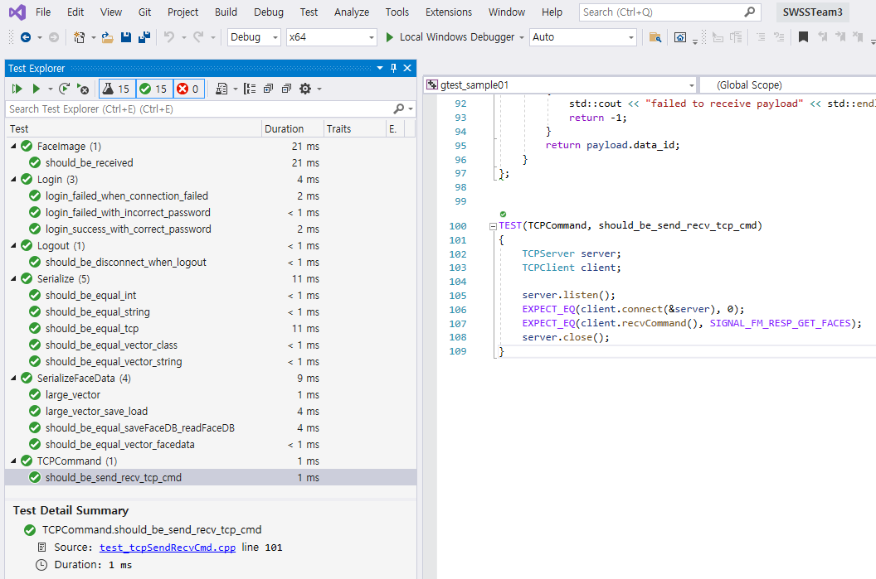
AACS Functional Test Results
Manual Test
Automatic Test (gTest)
- Functional test cases developed based on S/W requirements - Some test cases developed from Given- When-Then pattern
- The unit test cases and the basic scenario tests developed - 4 issues were detected and fixed based on automated tests
- 15 test cases developed
Item | Description
Test Scope | AACS Requirements
Requirement Test Coverage | 80%
Test Level | System Test
Test Method | Manual Test
Number of Test Cases | 49
Pass | 45
Fail | 4
Pass Rate | 91.8 %
Notes:
In the implement process, manual tests and automation tests were planned and executed.
The manual test confirmed 49 TCs of the system test level, which covers 80% of the test cases of the security requirement. A pass rate was 92%
For automation test, a unit test case and basic scenario test were applied, there are 15 test cases.
We were able to detect and fixed 4 issues by using it.

Slide 24
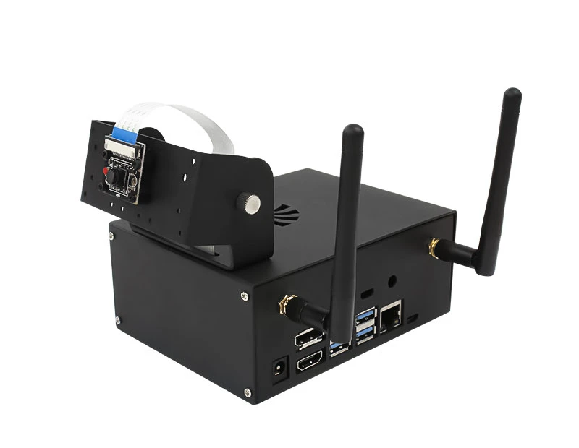
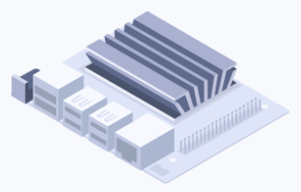
AACS Test Environment Improvements
The development environment was difficult to develop with one test board.
In some cases, performance was slow or the system crashed when multiple people connected to the board and tested it.
To solve this problem, a virtual jetson nano board was developed and used for testing.
real test environment
virtual test environment
Although it cannot operate with the same function as the actual jetson nano board, this kind of test simulator is useful for data communication testing using the protocol.
Notes:
In the development stage, it was inconvenient and had a difficulty for all teammates to share one test board. (that was high risk management)
To mitigate this point, a virtual test environment was set up on the control PC and used for testing.
It was possible to verify valid communication protocol.

Slide 25

It was a good opportunity to learn about the process of enforcing security in architecture.
The security was reflected in the design from the beginning, so the implementation had been well.
Lack of time was the biggest constraint, but we were able to overcome it through teamwork.
When faced with a problem in the project, I was able to learn how to apply to this project and to make a decision with discussion to solve the problem.
It's good to know the usage of openssl and learn from team mates about security manager implementation.
From design to deployment, I felt that secured software had a lot to consider and took time.
There were too many requirements to implement, but proper decision on what can be done in within given time help a lot to reach to a good shape.
We learned a lot from phase 1 and are looking forward to phase 2 !
Notes:
It’s our lessson & learned.
When faced with a problem in the project, I was able to learn how to apply to this project and to make a decision with discussion to solve the problem.

Slide 26

Notes:
Presentation is over. Do you have any question or comment?

